Slide 1
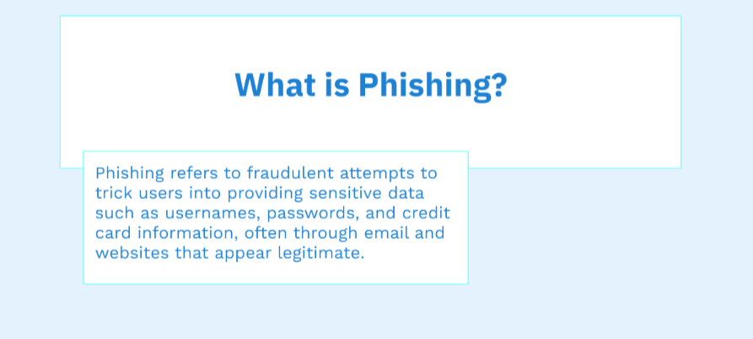
Name: Komal Mazhar Mushtaq
STUDENT ID: CA/D1/6190

Slide 2
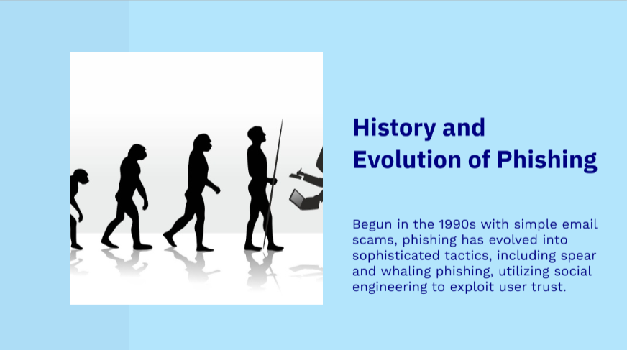

Slide 3
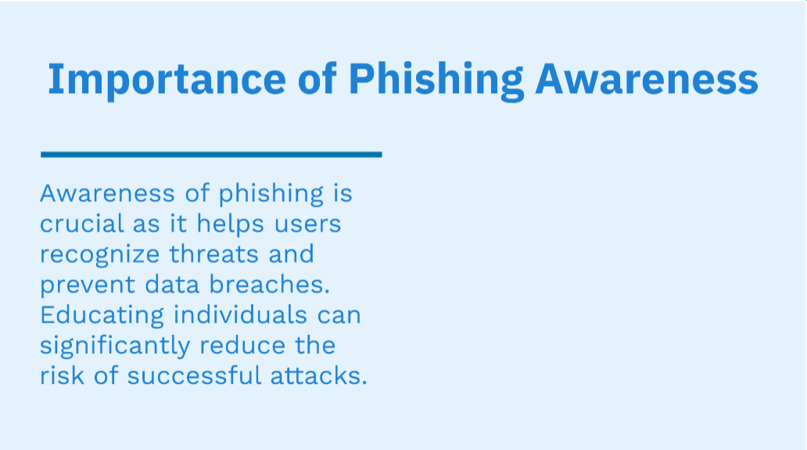
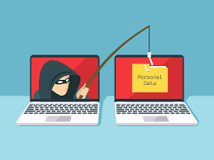

Slide 4
Impact of Phishing Attacks
• Financial Loss: Millions of dollars stolen annually.
• Identity Theft: Personal information used fraudulently.
• Organizational Risk: Data breaches and reputation damage.
• Malware and Ransomware: Delivered through phishing emails.

Slide 5
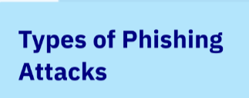
Email Phishing
Spear Phishing
Smishing
Vishing (Voice Phishing)
Clone Phishing

Slide 6
Continued
1. Email Phishing: Fake emails pretending to be from trusted sources.
2. Spear Phishing: Targeted attacks on individuals or organizations.
3. Smishing: Phishing via SMS or text messages.
4. Vishing: Phishing via voice calls.
5. Clone Phishing: Duplicate emails with malicious links.

Slide 7
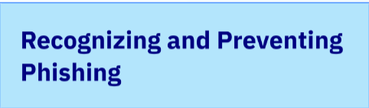

Slide 8
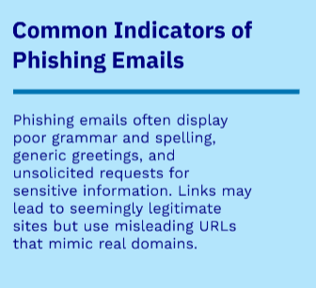
Recognizing Phishing Emails
• Generic Greetings (e.g., 'Dear Customer').
• Urgent Language (e.g., 'Act Now' or 'Immediate Action Required').
• Suspicious Links (hover over links to check).
• Unexpected Attachments.
• Spelling and Grammar Errors.

Slide 9
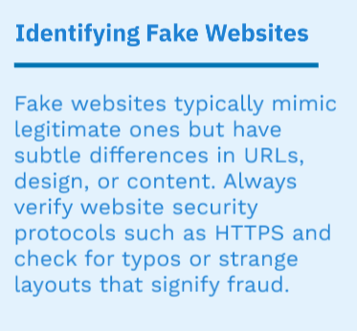
Spotting Phishing Websites
• Check the URL: Look for 'https' and spelling errors.
• Avoid Clicking on Links from Untrusted Sources.
• Use Trusted Bookmarks for Important Websites.
• Look for Security Indicators (padlock icon in the browser).

Slide 10
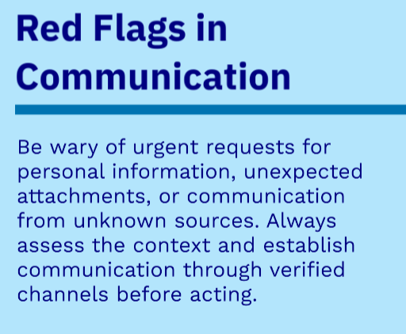
Tricks Used by Attackers
• Pretending to be someone you trust (e.g., a boss or IT support).
• Creating fake urgency to act quickly.
• Exploiting emotions like fear or curiosity.
• Building trust over time (pretexting).

Slide 11
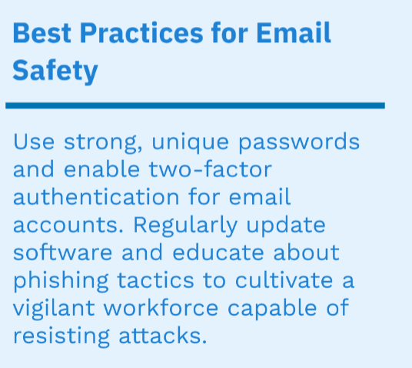
Best Practices for Staying Safe
• Verify the Sender: Contact them through official channels.
• Don't Click Suspicious Links or Attachments.
• Enable Two-Factor Authentication (2FA).
• Regularly Update Your Software.
• Use Anti-Phishing Filters in Email Programs.

Slide 12
Tools and Technologies for Protection
Steps Organizations Can Take
Email filters, anti-phishing tools, and browser extensions can help detect and block phishing attempts. Organizations should also consider implementing cybersecurity training programs to keep employees informed about new threats.
• Conduct Regular Phishing Awareness Training.
• Simulate Phishing Attacks to Test Employees.
• Implement Email Filtering Solutions.
• Monitor and Respond to Security Alerts Promptly.
• Establish a Reporting Process for Phishing Attempts.

Slide 13
Steps to Take After a Phishing Attack
1. Disconnect:
Immediately disconnect from the network to prevent further compromise.
1
2. Alert:
Inform your IT team or security personnel about the attack.
2
3. Change Passwords:
Update passwords for compromised accounts.
3
4. Scan for Malware:
Run antivirus scans on affected devices.
4
5. Report:
Report the phishing attempt to relevant authorities or organizations.
5
6. Monitor Accounts:
Keep an eye on your financial and online accounts for unusual activity.
6
7. Educate:
Raise awareness among employees or users about phishing attacks.
7

Slide 14
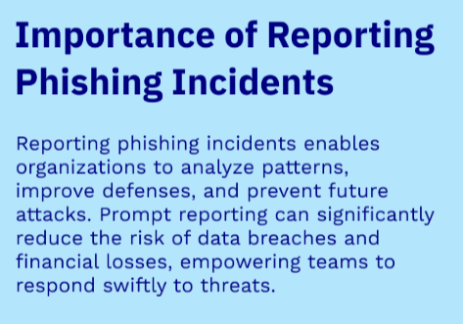
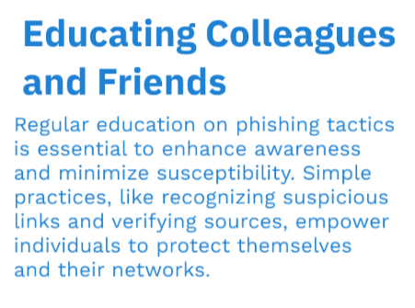
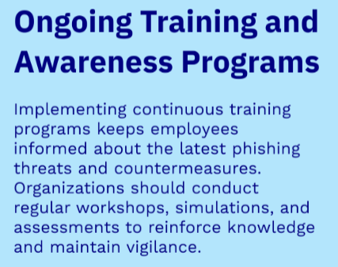
Reporting and Educating

Slide 15
Famous Phishing Incidents
• Google and Facebook: Lost $100M to phishing scams.
• Target: Phishing led to a massive data breach.
• Sony Pictures: Spear phishing resulted in stolen sensitive emails.

Slide 16
Stay Vigilant!
Phishing is a constant threat but can be mitigated through awareness and caution.
• Report suspicious emails and educate others.
• Remember: Think before you click!

